Slide 1
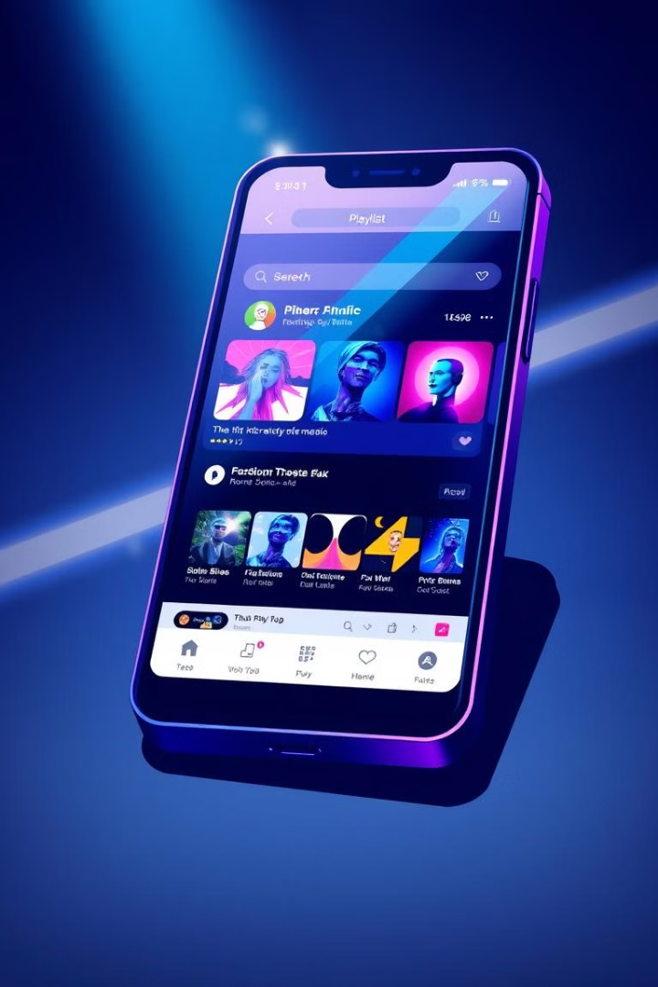

Social Music App
This presentation explores the development of a social music app that allows users to listen to music, connect with friends, and share playlists.
by Ankit Shekhawat
Roll No. 20222713
Univ Roll No. 22020107036

Slide 2
Table of Contents
About
Features
Tech Stack
Installation
Usage
System Architecture
Contributing

Slide 3
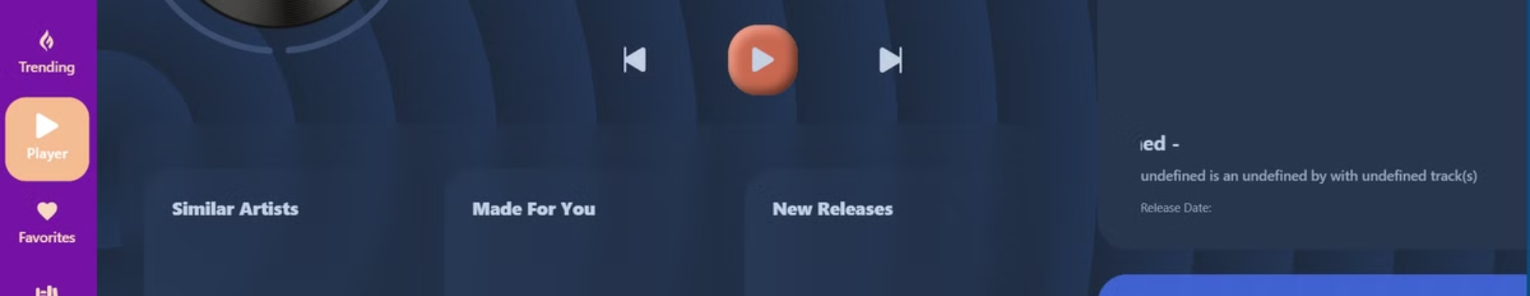
About
The Social Music App provides a user-friendly interface for exploring and sharing music tracks from various sources. This app is built using React.js, Node.js, and integrates with the Spotify API for music streaming.

Slide 4
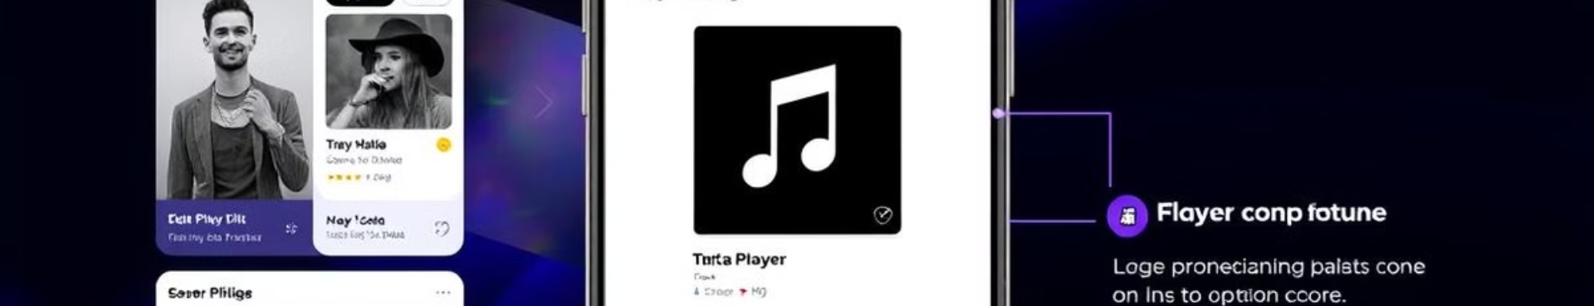
Features
User Authentication
Playlist Creation
Users can sign up and log in using their credentials.
Users can create custom playlists and share them with their friends.
Music Streaming
Social Integration
Music tracks can be streamed directly within the app from Spotify.
Users can follow friends and see what they are listening to in real-time.

Slide 5
Tech Stack
Frontend
Backend
API
React.js
Node.js
Spotify API
Redux
Express.js
React Router
Axios
React Icons

Slide 6
Installation
This section outlines the steps required to install the Social Music App on a local development environment.
Prerequisites
1
Node.js and Git are required.
Clone Repository
2
Use `git clone` to clone the repository.
Install Dependencies
3
Run `npm install` to install project dependencies.

Slide 7
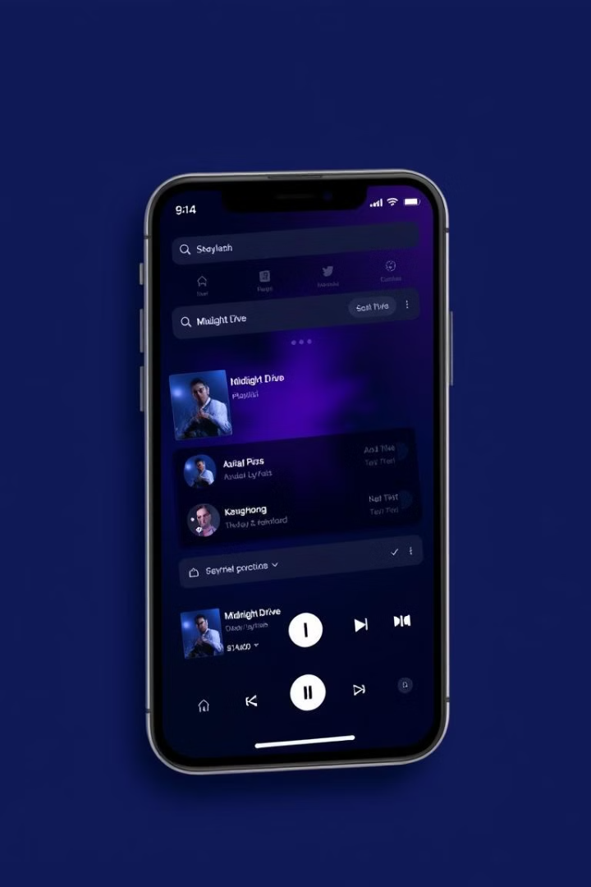




Usage
This section explains how to use the Social Music App's features once the application is successfully installed and running locally.
Sign Up/Login
Search for Music
Create a new account or log in with existing credentials.
Search for songs, albums, or artists.
Create Playlists
Music Streaming
Create and share playlists with friends.
Stream music directly from Spotify via API integration.

Slide 8
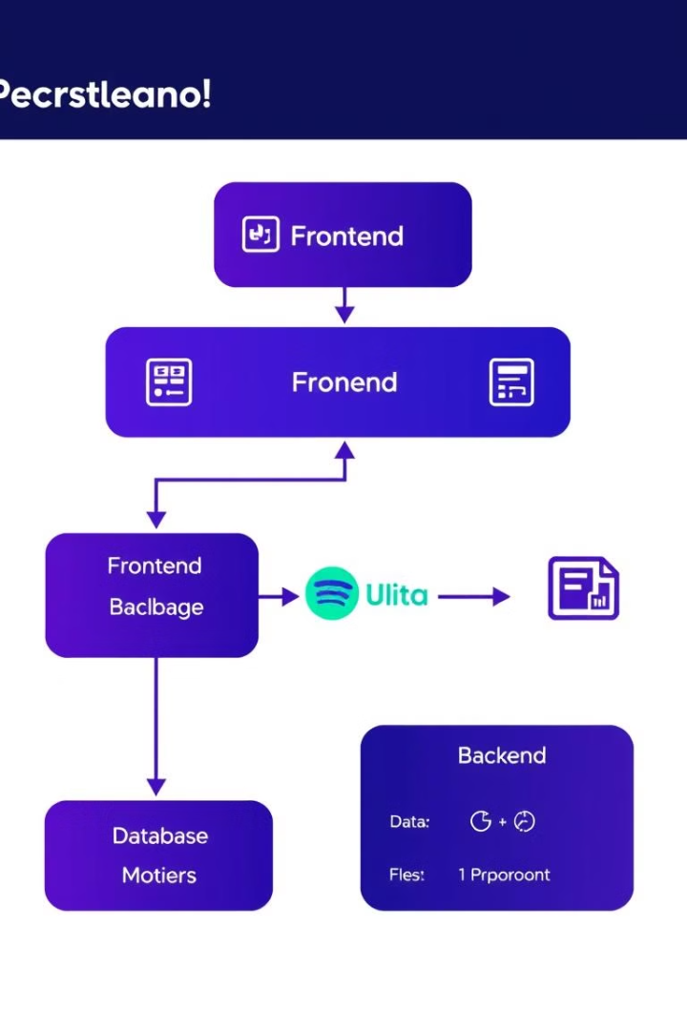
System Architecture
1
Frontend
User interaction through the React.js frontend.
2
Backend
Authentication, playlist management, and API integration.
3
Database
Stores user profiles, playlists, and other data.
4
Spotify API
Provides music streaming, search, and song details.

Slide 9





Contributing
This section provides guidance on how to contribute to the Social Music App project.
Fork Repository
Create a copy of the repository.
Create Branch
Create a new branch for your changes.
Make Changes
Make your changes and commit them.
Push to Forked Repository
Push your changes to your forked repository.
Create Pull Request
Submit your changes for review.

